Slide 1
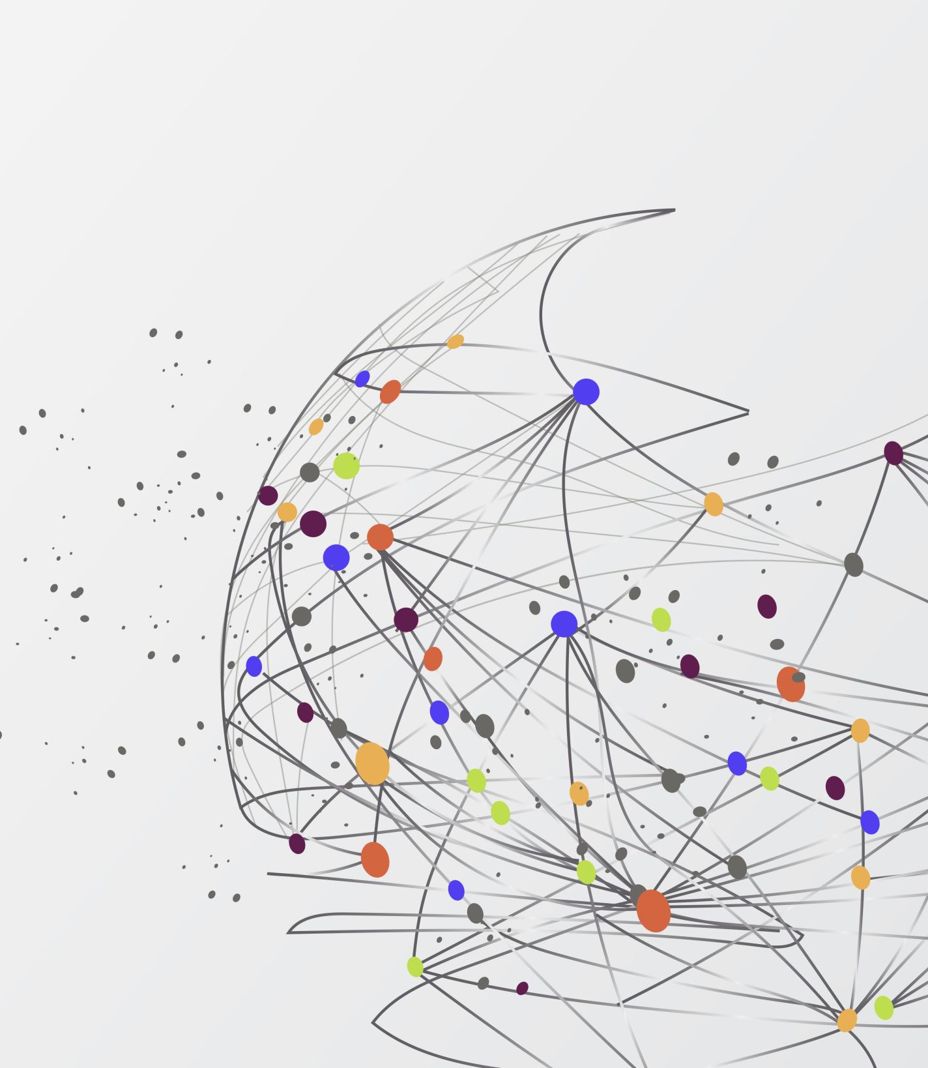
Asymmetric Information I HE3001, Microeconomics 3 Nanyang Technological University

Slide 2
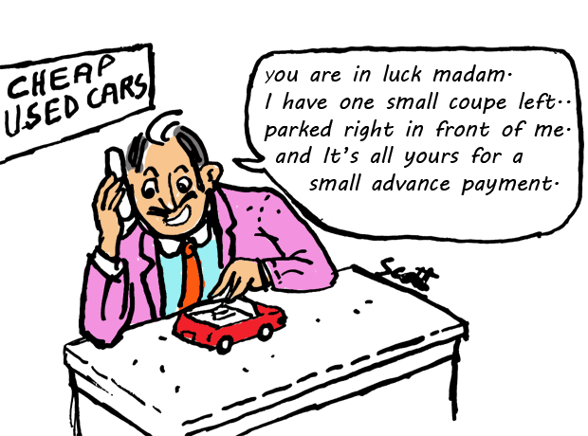
Introduction
In purely competitive markets, all agents are fully informed about traded commodities and other aspects of the market.
However, in real life, there is often asymmetric information:
Some parties are better informed than others about the outcomes of some environment; they have hidden information.

Slide 3
Asymmetric Information
When information is asymmetric, this can lead to market inefficiencies
Over the next two lectures, we will discuss 2 main classes of asymmetric information
Adverse Selection: Unobserved types of agents
Moral Hazard: Unobserved actions by agents
Related to games of incomplete/imperfect information respectively from before.
Notes:
Different types could have different payoffs, so if not observed, it means there is no full knowledge of the payoff structure of everyone’s game.

Slide 4
Adverse Selection
Hidden information about someone’s type (Payoffs* and Action Set, see Lecture 1)
For example,
An insurance buyer knows more about his riskiness than does the seller. There is hidden information (to the seller) about the buyers’ utility from taking dangerous actions.
A used car’s owner knows more about its value than does a potential buyer. There is hidden information (to the buyer) about the sellers’ potential payoffs from keeping the car.
Because of this, the beliefs of the party who has incomplete information will affect outcomes in the market!
We will now take a look at a simple model of this.
Notes:
We will focus on hidden information about payoffs.
This is because if different types have different actions, we can always focus on a common set of actions, but if a type does not have a particular action, we can always set his/her payoffs from it to be negative infinity.

Slide 5
Adverse Selection the Market for Lemons

Slide 6
Adverse Selection: The Market for Lemons
Consider a used car market with two types of cars; “lemons” and “peaches”.
Lemon sellers value their car at $1000. Buyers value lemons at $1200
I.e. Each lemon seller will accept at least $1,000; a buyer will pay at most $1,200.
Peach sellers value their car at $2,000. Buyers value peaches at $2400.
I.e. Each peach seller will accept at least $2000; a buyer will pay at most $2,400.
Notes:
Given that there are two different types which are unknown, this is related to games of incomplete information where knowledge about types matters.

Slide 7
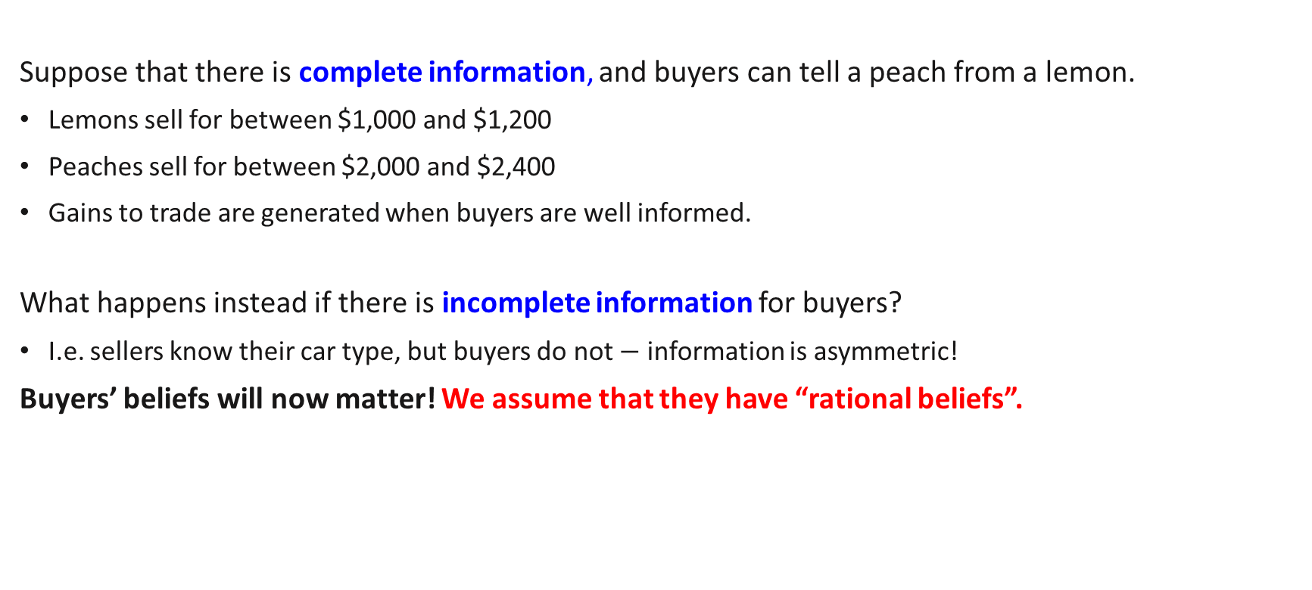
Adverse Selection: The Market for Lemons
Suppose that there is complete information, and buyers can tell a peach from a lemon.
Lemons sell for between $1,000 and $1,200
Peaches sell for between $2,000 and $2,400
Gains to trade are generated when buyers are well informed.
What happens instead if there is incomplete information for buyers?
I.e. sellers know their car type, but buyers do not $−$ information is asymmetric!
Buyers’ beliefs will now matter! We assume that they have “rational beliefs”.

Slide 8
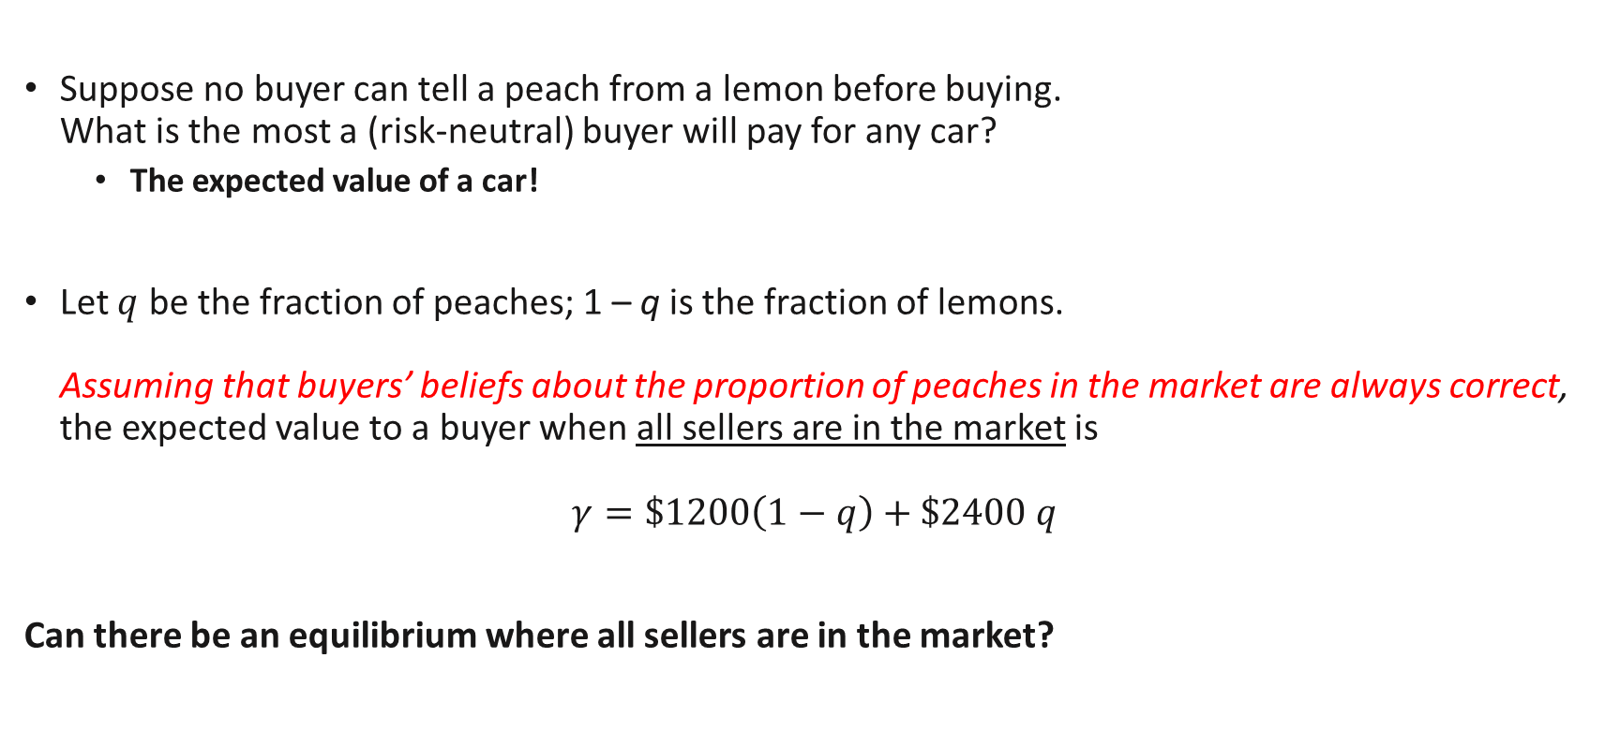
Adverse Selection: The Market for Lemons
Suppose no buyer can tell a peach from a lemon before buying. What is the most a (risk-neutral) buyer will pay for any car?
The expected value of a car!
Let $q$ be the fraction of peaches; 1 – q is the fraction of lemons. Assuming that buyers’ beliefs about the proportion of peaches in the market are always correct, the expected value to a buyer when all sellers are in the market is
$$γ=\$1200\left(1−q\right)+\$2400 q$$
Can there be an equilibrium where all sellers are in the market?
Rational beliefs

Slide 9
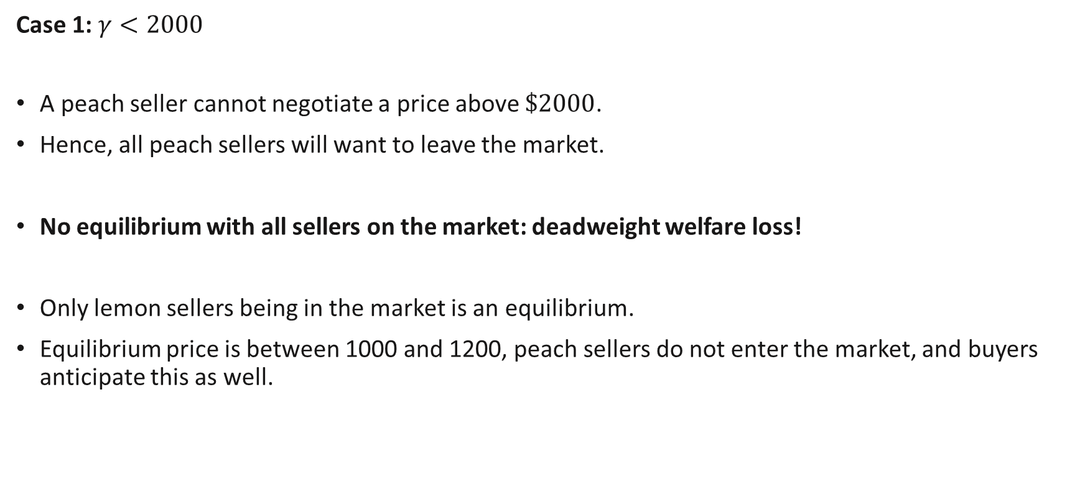
Adverse Selection: The Market for Lemons
Case 1: $γ<2000$
A peach seller cannot negotiate a price above $\$2000$.
Hence, all peach sellers will want to leave the market.
No equilibrium with all sellers on the market: deadweight welfare loss!
Only lemon sellers being in the market is an equilibrium.
Equilibrium price is between 1000 and 1200, peach sellers do not enter the market, and buyers anticipate this as well.
Notes:
With only lemon sellers in the market, buyers correctly believe that the proportion of peaches in the market is 0.

Slide 10
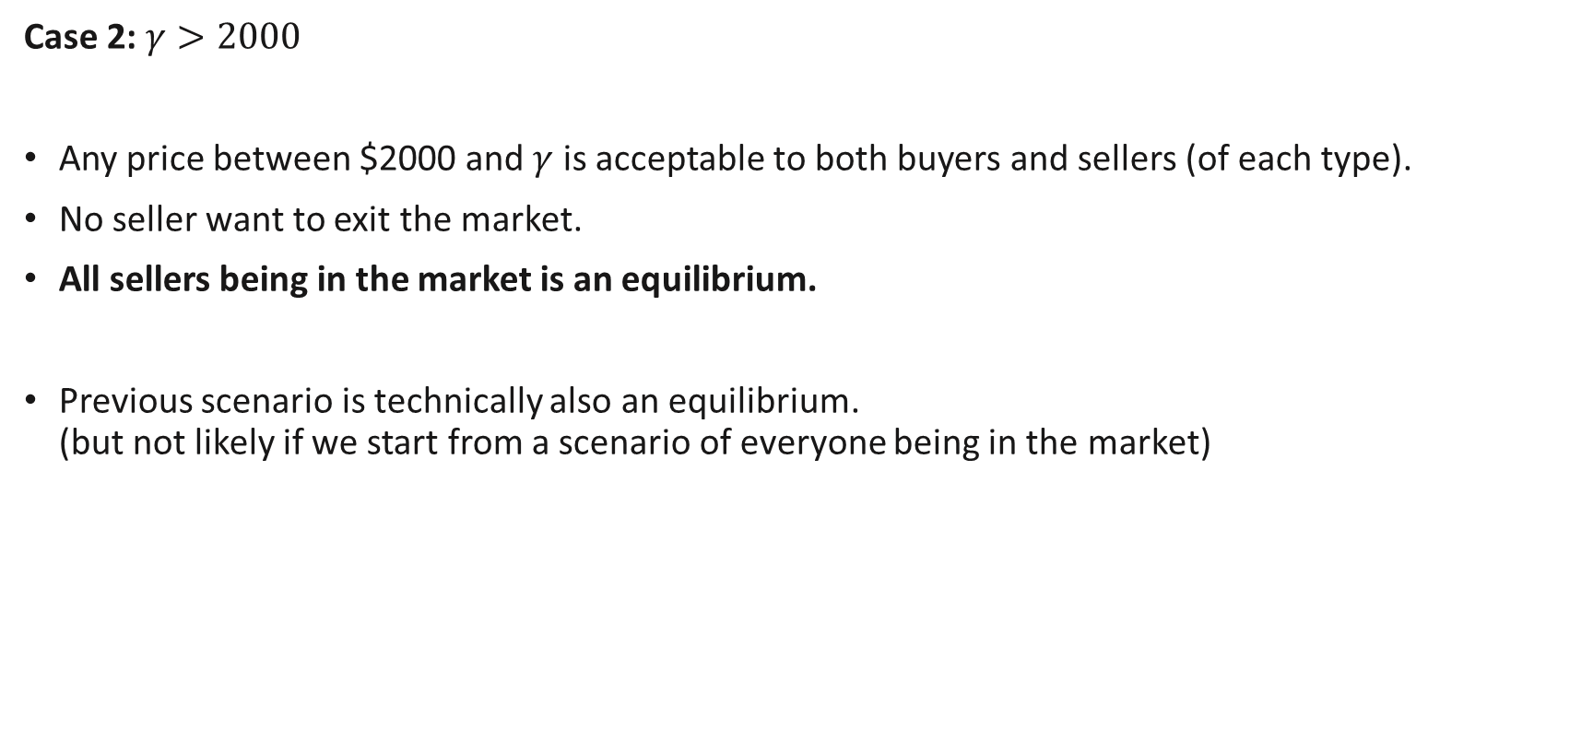
Adverse Selection: The Market for Lemons
Case 2: $γ>2000$
Any price between $2000 and $γ$ is acceptable to both buyers and sellers (of each type).
No seller want to exit the market.
All sellers being in the market is an equilibrium.
Previous scenario is technically also an equilibrium. (but not likely if we start from a scenario of everyone being in the market)

Slide 11
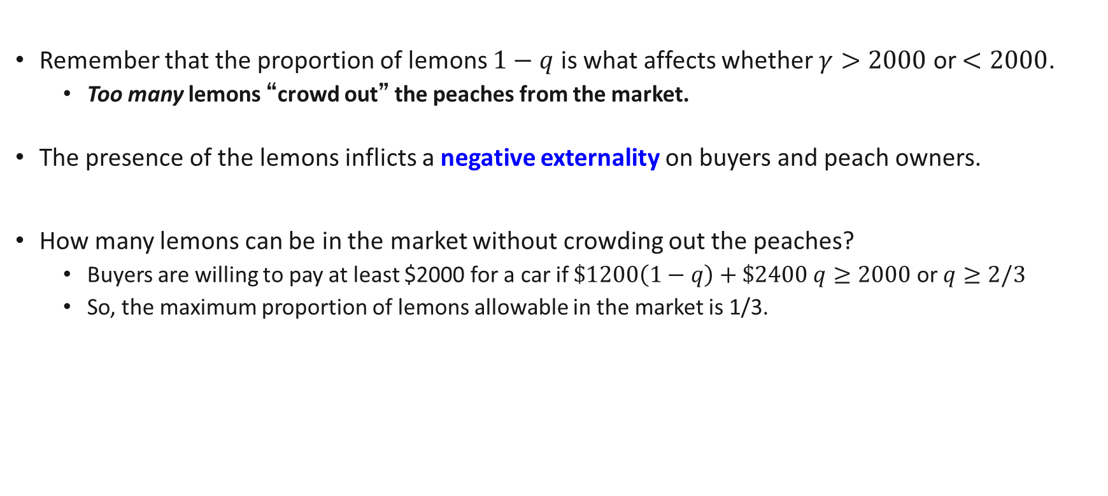
Adverse Selection: The Market for Lemons
Remember that the proportion of lemons $1−q$ is what affects whether $γ>2000$ or $<2000$.
Too many lemons “crowd out” the peaches from the market.
The presence of the lemons inflicts a negative externality on buyers and peach owners.
How many lemons can be in the market without crowding out the peaches?
Buyers are willing to pay at least $2000 for a car if $\$1200\left(1−q\right)+\$2400 q≥2000$ or $q≥2/3$
So, the maximum proportion of lemons allowable in the market is 1/3.

Slide 12
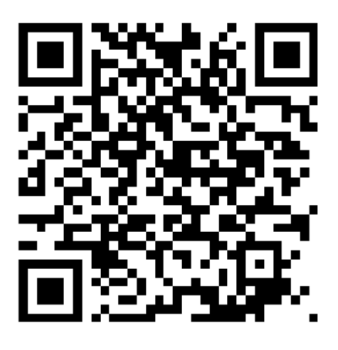
Review Questions 1
Consider the similar scenario to before. Buyers value peaches at $3000 and lemons at $1000. Sellers value peaches at $2500 and lemons at $1500. Assume that prices are just buyers’ expected value and that we start out with all sellers on the market.
If there is complete information, which sellers will remain on the market? Only peaches
If there is incomplete information, with the proportion of lemons = 4/5. What kind of market equilibrium will we end up at? EV = 1400. No cars will be in the market, no equilibrium.
If there is incomplete information, with the proportion of lemons = 1/5. What kind of market equilibrium will we end up at? EV = 2600. Both cars will be in the market – equilibrium.

Slide 13

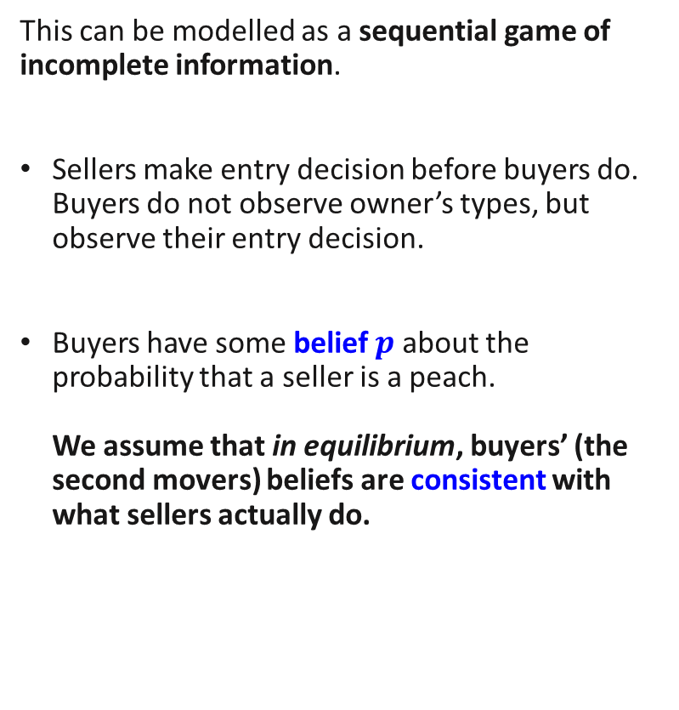





Market for Lemons and Game Theory
This can be modelled as a sequential game of incomplete information.
Sellers make entry decision before buyers do. Buyers do not observe owner’s types, but observe their entry decision.
Buyers have some belief $p$ about the probability that a seller is a peach. We assume that in equilibrium, buyers’ (the second movers) beliefs are consistent with what sellers actually do.
Buy at price $x$
Peach Seller
In
Out
$$p$$
$$q$$
Peach
Do not Buy
Buyer
Nature
Buy at price $x$
$$1−p$$
$$1−q$$
Lemon
In
Lemon Seller
Out
Do not Buy

Slide 14
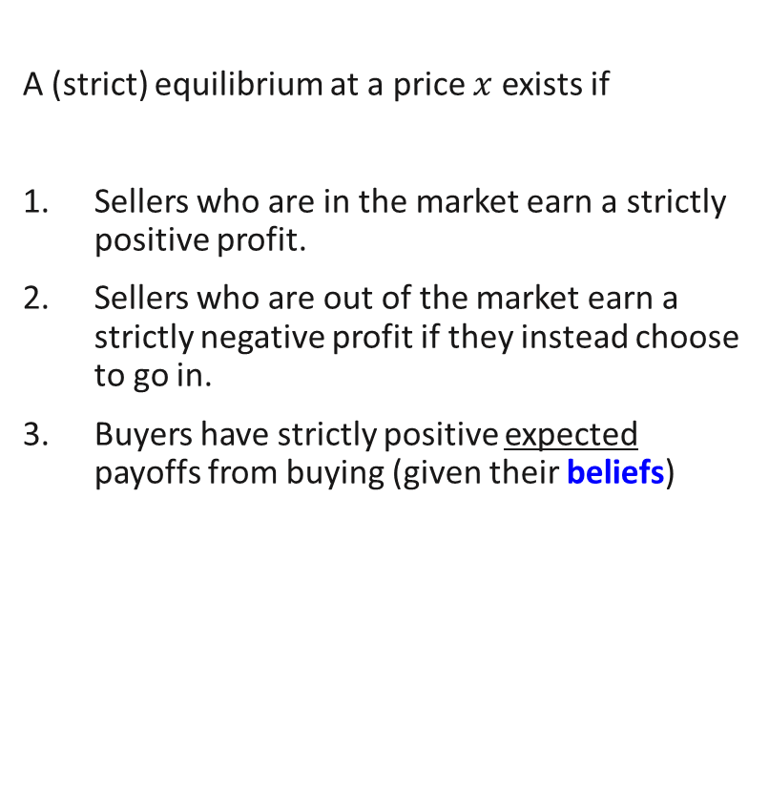

Market for Lemons and Game Theory
A (strict) equilibrium at a price $x$ exists if
Sellers who are in the market earn a strictly positive profit.
Sellers who are out of the market earn a strictly negative profit if they instead choose to go in.
Buyers have strictly positive expected payoffs from buying (given their beliefs)
Buy at price $x$
Peach Seller
In
Out
$$p$$
$$q$$
Peach
Do not Buy
Buyer
Nature
Buy at price $x$
$$1−p$$
$$1−q$$
Lemon
In
Lemon Seller
Out
Do not Buy
Notes:
What we are looking for is for a market with a price $x$ where at least some of the owners are selling their cars.

Slide 15
Market for Lemons and Game Theory
This is what we call a Bayesian Nash Equilibrium.
Same as Nash Equilibrium, but with beliefs.
Given the Seller’s strategy, Buyer’s have the correct beliefs about who is in the market and their strategy must be a best response.
Buy at price $x$
Peach Seller
In
Out
$$p$$
$$q$$
Peach
Do not Buy
Buyer
Nature
Buy at price $x$
$$1−p$$
$$1−q$$
Lemon
In
Lemon Seller
Out
Do not Buy

Slide 16
An aside: The role of Nature
Notice that we used a trick to model this game of incomplete information..
We introduced a new player “Nature”.
Nature “chooses” which type the players with less information (the buyers) will face.
Nature is assumed to be indifferent between her choices of each type of players
Any mixture of types in her choice is a “best response”.
Essentially, this means that we can just let the true distribution of types be Nature’s “strategy” in the Bayesian Nash Equilibirum.

Slide 17

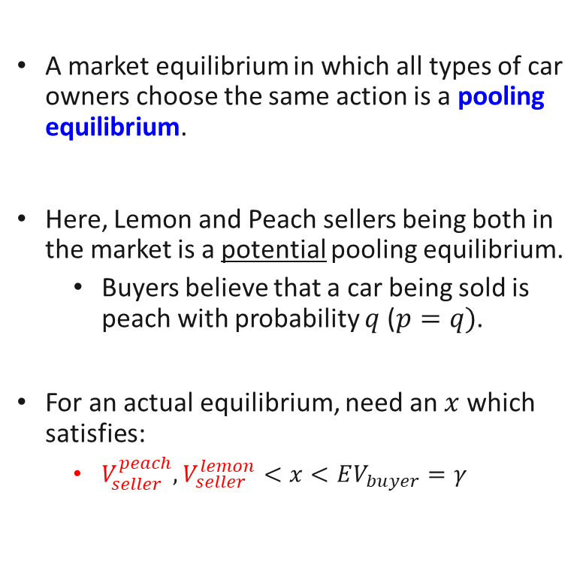

The Market for Lemons: Pooling Equilibrium
A market equilibrium in which all types of car owners choose the same action is a pooling equilibrium.
Here, Lemon and Peach sellers being both in the market is a potential pooling equilibrium.
Buyers believe that a car being sold is peach with probability $q$ ($p=q)$.
For an actual equilibrium, need an $x$ which satisfies:
$V_{seller}^{peach},V_{seller}^{lemon}<x<EV_{buyer}=γ$
Buy at price $x$
Peach Seller
In
Out
$$q$$
$$q$$
Peach
Do not Buy
Buyer
Nature
Buy at price $x$
$$1−q$$
$$1−q$$
Lemon
in
Lemon Seller
Out
Do not Buy
Notes:
$γ$ is from slide 8

Slide 18

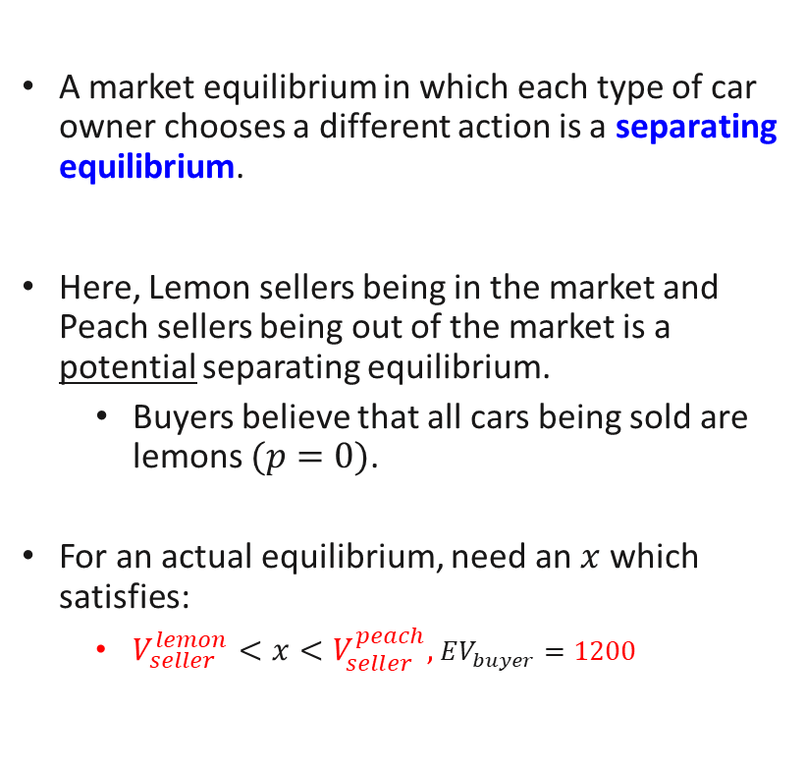

The Market for Lemons: Separating Equilibrium
A market equilibrium in which each type of car owner chooses a different action is a separating equilibrium.
Here, Lemon sellers being in the market and Peach sellers being out of the market is a potential separating equilibrium.
Buyers believe that all cars being sold are lemons $(p=0)$.
For an actual equilibrium, need an $x$ which satisfies:
$V_{seller}^{lemon}<x<V_{seller}^{peach},EV_{buyer}=1200$
Buy at price $x$
Peach Seller
In
Out
$$0$$
$$q$$
Peach
Do not Buy
Buyer
Nature
Buy at price $x$
$$1$$
$$1−q$$
Lemon
In
Lemon Seller
Out
Do not Buy

Slide 19


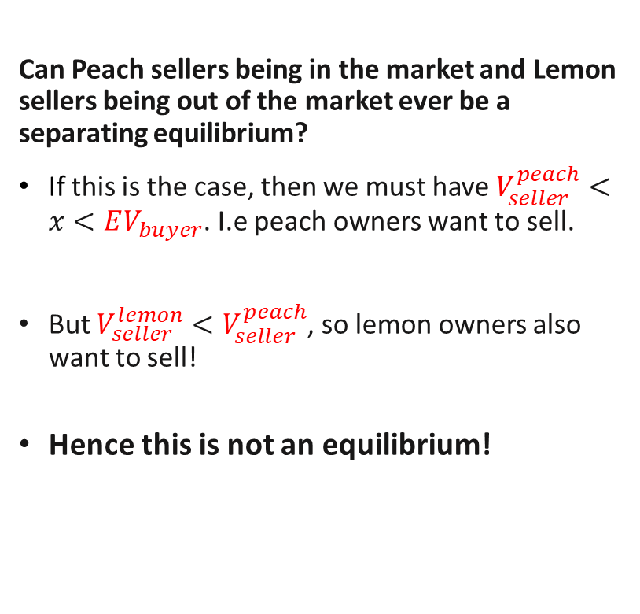

The Market for Lemons: Separating Equilibrium?
Can Peach sellers being in the market and Lemon sellers being out of the market ever be a separating equilibrium?
If this is the case, then we must have $V_{seller}^{peach}<x<EV_{buyer}$. I.e peach owners want to sell.
But $V_{seller}^{lemon}<V_{seller}^{peach}$, so lemon owners also want to sell!
Hence this is not an equilibrium!
Buy at price $x$
Peach Seller
In
Out
$$1$$
$$q$$
Peach
Do not Buy
Buyer
Nature
Buy at price $x$
$$0$$
$$1−q$$
Lemon
In
Lemon Seller
Out
Do not Buy
Notes:
This result holds more generally!

Slide 20

Review Questions 2
Buyers value peaches at $3000 and lemons at $2000. Sellers value peaches at $2500 and lemons at $1500. For the proportion of peaches $q=0.2$, illustrate an equilibrium.

Slide 21
An extension of the market for lemons

Slide 22
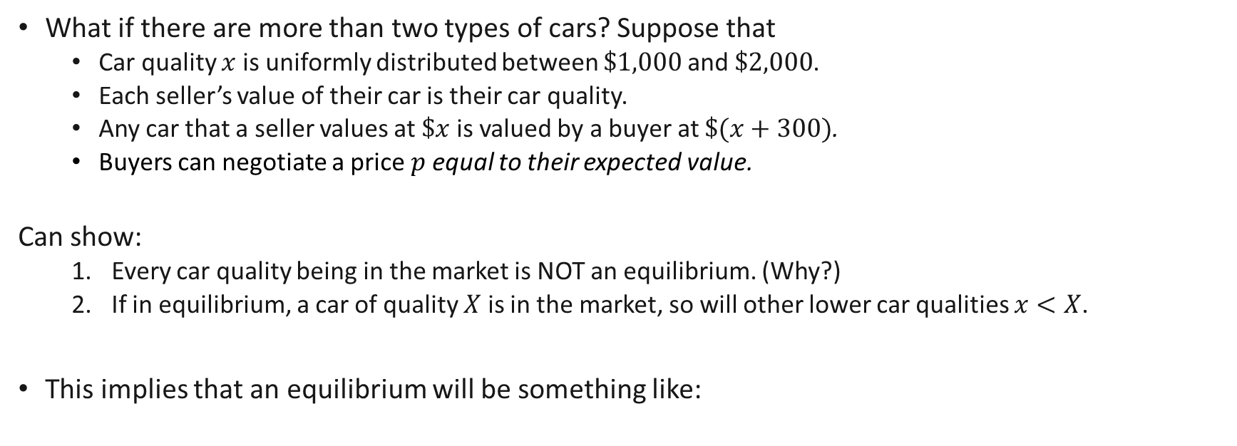

Adverse Selection: The Market for Lemons II
What if there are more than two types of cars? Suppose that
Car quality $x$ is uniformly distributed between $\$1,000$and $\$2,000$.
Each seller’s value of their car is their car quality.
Any car that a seller values at $\$x$ is valued by a buyer at $\$(x+300)$.
Buyers can negotiate a price $p$equal to their expected value.
Can show:
Every car quality being in the market is NOT an equilibrium. (Why?)
If in equilibrium, a car of quality $X$ is in the market, so will other lower car qualities $x<X$.
This implies that an equilibrium will be something like:
Car quality
In
Out
$${p=v}_{H}$$
Notes:
Idea is that we first start out with a potential pooling equilibrium, and then slowly remove the higher value sellers who don’t want to remain.
(We know from before that it can’t be that higher value sellers remain, but lower value sellers do not.)

Slide 23
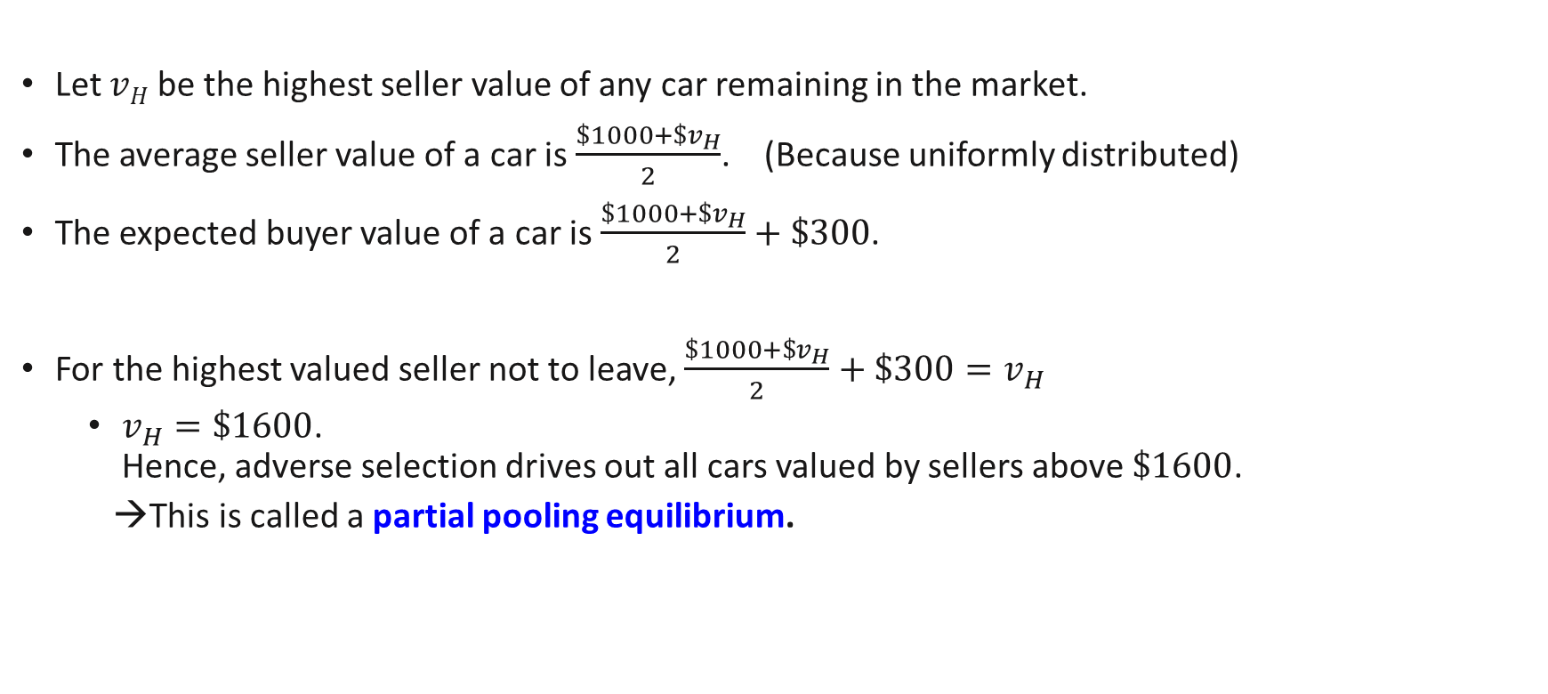
Adverse Selection: The Market for Lemons II
Let $vH$ be the highest seller value of any car remaining in the market.
The average seller value of a car is $\frac{\$1000+\$v_{H}}{2}$. (Because uniformly distributed)
The expected buyer value of a car is $\frac{\$1000+\$v_{H}}{2}+\$300$.
For the highest valued seller not to leave, $\frac{\$1000+\$v_{H}}{2}+\$300=v_{H}$
$v_{H}=\$1600$. Hence, adverse selection drives out all cars valued by sellers above $\$1600$.
→This is called a partial pooling equilibrium.

Slide 24
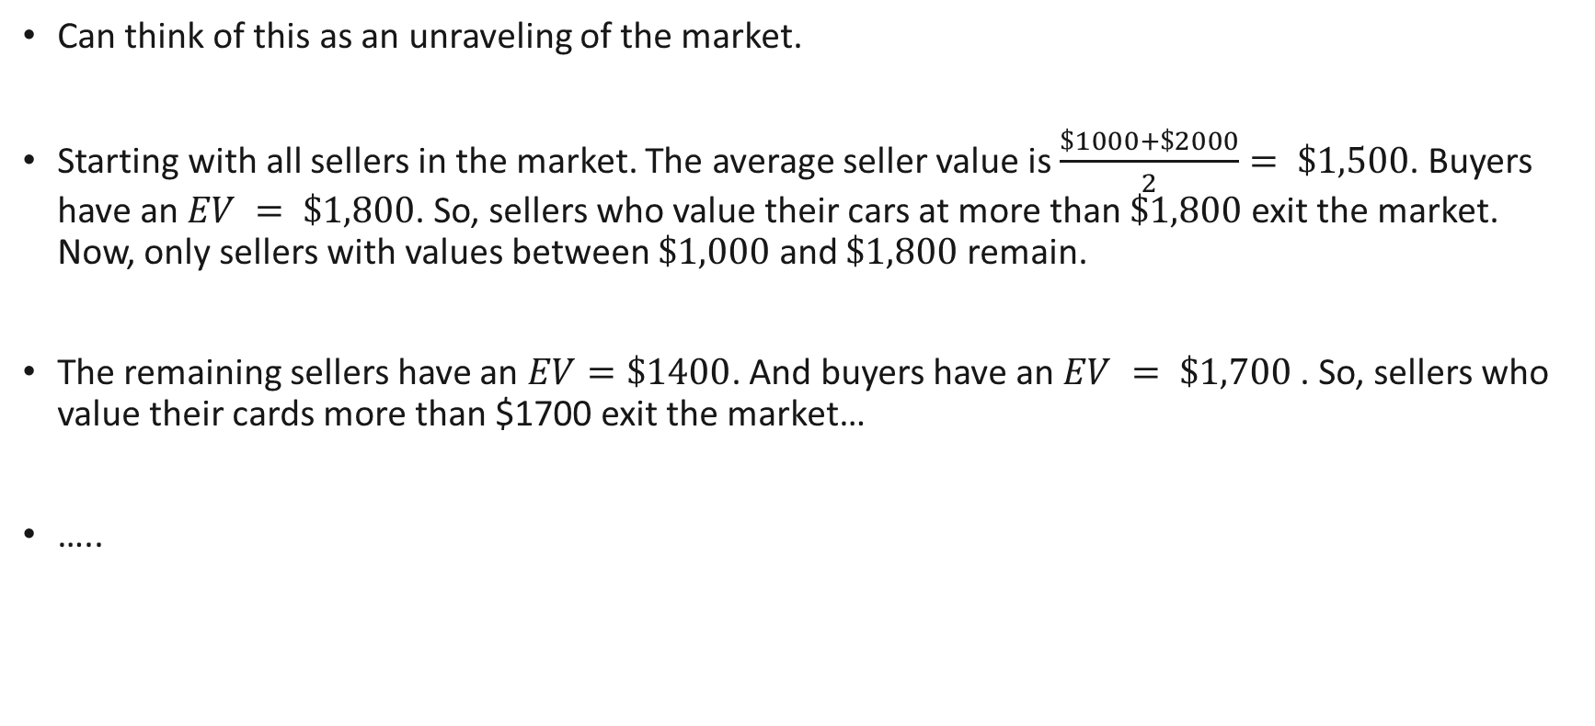
Adverse Selection: The Market for Lemons II
Can think of this as an unraveling of the market.
Starting with all sellers in the market. The average seller value is $\frac{\$1000+\$2000}{2}= \$1,500$. Buyers have an $EV = \$1,800$. So, sellers who value their cars at more than $\$1,800$exit the market. Now, only sellers with values between $\$1,000$ and $\$1,800$ remain.
The remaining sellers have an $EV=\$1400$. And buyers have an $EV = \$1,700$ . So, sellers who value their cards more than $1700 exit the market…
…..
Notes:
Idea is that we first start out with a potential pooling equilibrium, and then slowly remove the higher value sellers who don’t want to remain.
(We know from before that it can’t be that higher value sellers remain, but lower value sellers do not.)

Slide 25
Discussion
What goes wrong here?
Buyers don’t know car quality, but perhaps seller can tell them?
But talk is cheap: every seller is going to claim his/her car is a peach. Hence, no credible way to inform buyers.
Lemon sellers impose a negative externality on peach sellers when they decide to sell on the market as they lower buyer’s willingness to pay for a car.
Risk aversion on the part of buyers will worsen the situation (their actual valuation is lower).
Sometimes, markets can completely disappear due to adverse selection!
For example, if low quality cars are valued by sellers more than buyers.

Slide 26
Signalling in the market for lemons

Slide 27
Signalling
Adverse selection is an outcome of informational deficiency.
What if information can be improved by high-quality sellers signalling credibly that they are high-quality?
For example, providing warranties, professional credentials, references from previous clients, etc.
Notice that these are all costly in some way, and there are potential differences in costs by each “type”.

Slide 28
Signalling (General Idea)
You took an exam which has a 50% chance of failing. After taking the exam, you have a gut feeling about your result (which is always correct). You need to decide how to interact with your parents. Consider the scenario where you have the gut feeling that you failed.. You can either 1) Act happy ☺, or 2) Act sad ☹.
What will you choose to do…? Depends on:
What your parents believe about your failure and how they will respond (e.g. be angry, or console you)
Their beliefs will depend on how you usually behave! Suppose you don’t want your parents to discover that you failed:
If you are usually a gloomy person… Maybe it’s better to act sad…
If you are usually a cheerful person… Maybe it’s better to act happy instead..
Your behaviour has signalling power!
Notes:
Beliefs affect how they respond, and how they respond affects your utility.

Slide 29
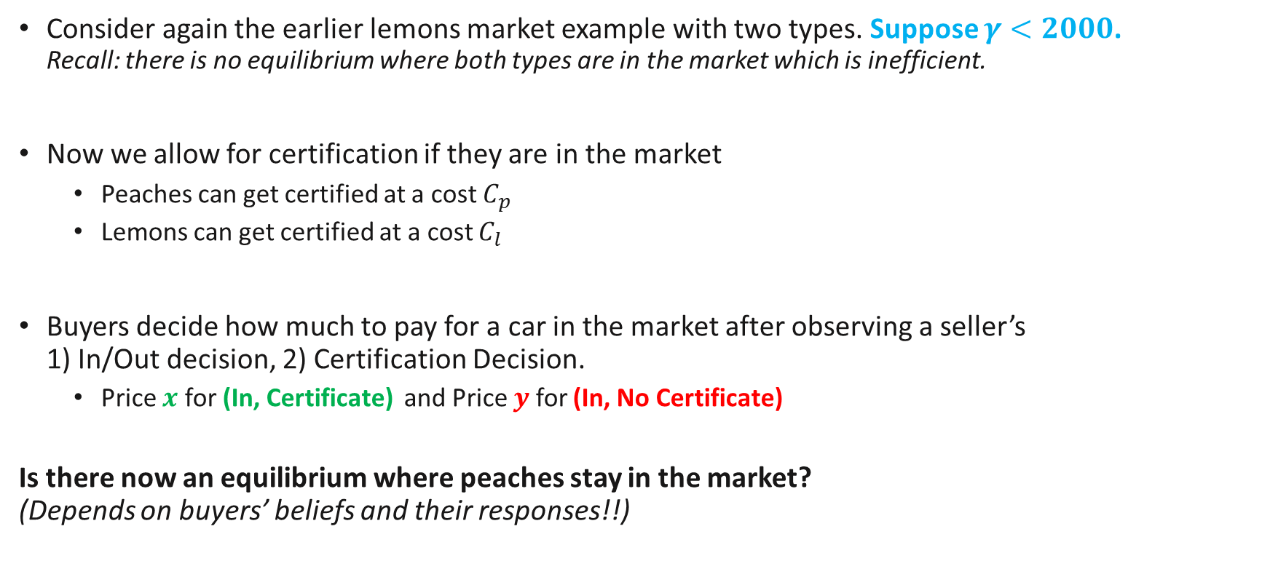
Lemons Market Signalling
Consider again the earlier lemons market example with two types. Suppose $γ<2000$. Recall: there is no equilibrium where both types are in the market which is inefficient.
Now we allow for certification if they are in the market
Peaches can get certified at a cost $C_{p}$
Lemons can get certified at a cost $C_{l}$
Buyers decide how much to pay for a car in the market after observing a seller’s 1) In/Out decision, 2) Certification Decision.
Price $x$ for (In, Certificate) and Price $y$ for (In, No Certificate)
Is there now an equilibrium where peaches stay in the market? (Depends on buyers’ beliefs and their responses!!)
Notes:
They only observe cars in the market and whether they have certification or not.

Slide 30
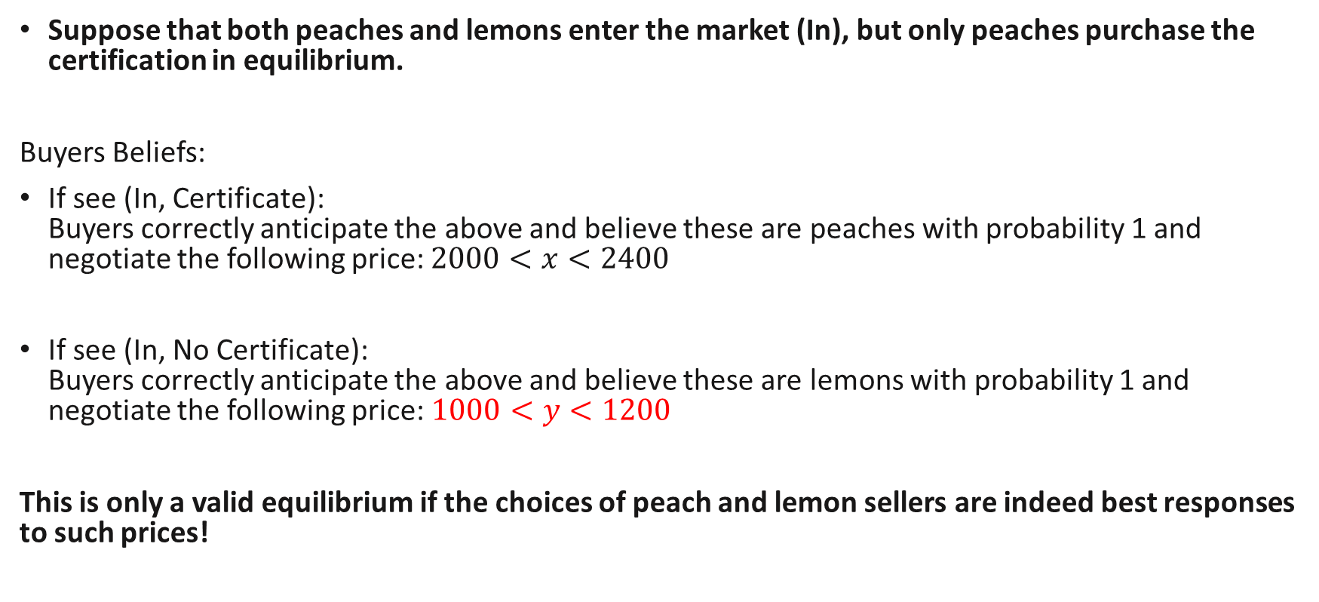
Separating Equilibrium (with signalling)
Suppose that both peaches and lemons enter the market (In), but only peaches purchase the certification in equilibrium.
Buyers Beliefs:
If see (In, Certificate): Buyers correctly anticipate the above and believe these are peaches with probability 1 and negotiate the following price: $2000<x<2400$
If see (In, No Certificate): Buyers correctly anticipate the above and believe these are lemons with probability 1 and negotiate the following price:$1000<y<1200$
This is only a valid equilibrium if the choices of peach and lemon sellers are indeed best responses to such prices!
These prices ensure positive surplus.

Slide 31
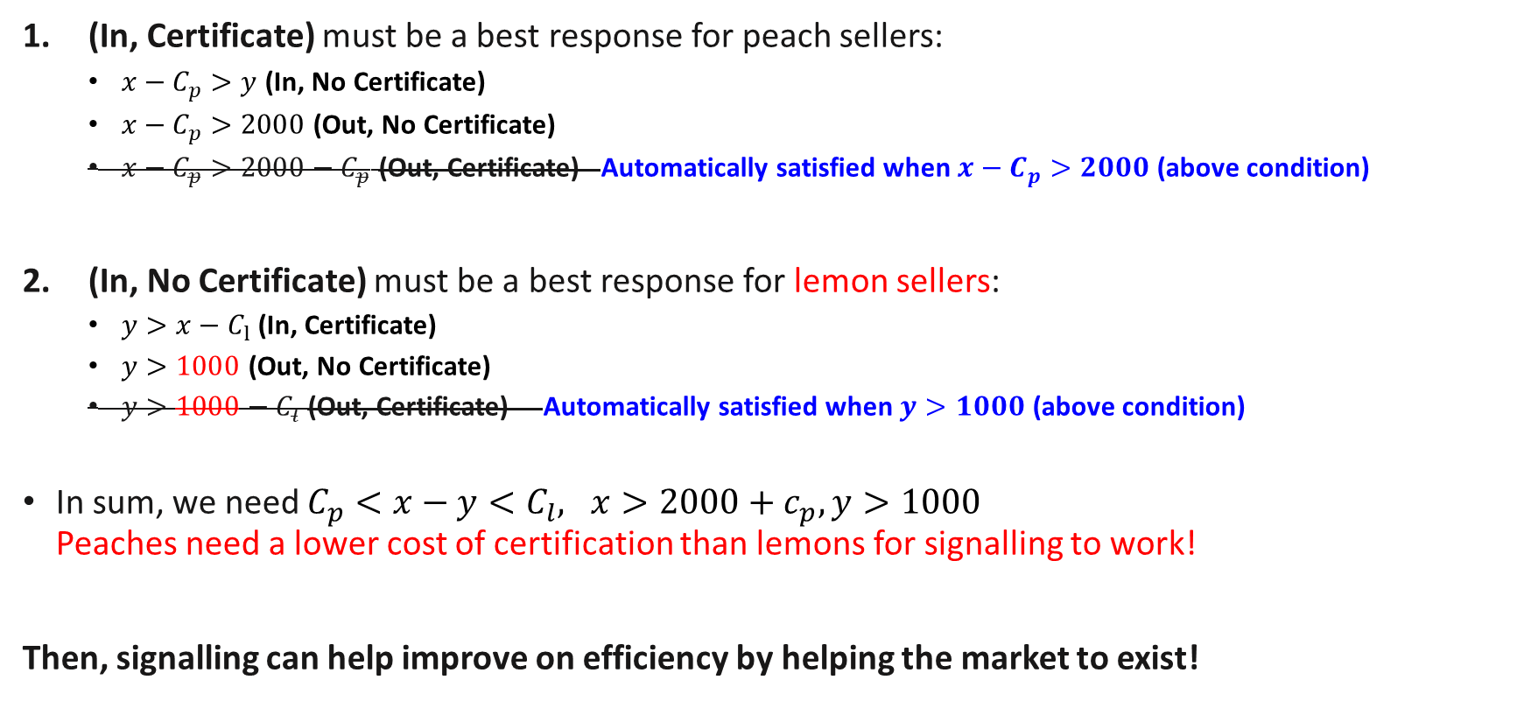
Separating Equilibrium (with signalling)
(In, Certificate) must be a best response for peach sellers:
$x−C_{p}>y$(In, No Certificate)
$x−C_{p}>2000$ (Out, No Certificate)
$x−C_{p}>2000−C_{p}$ (Out, Certificate) Automatically satisfied when $x−C_{p}>2000$ (above condition)
(In, No Certificate) must be a best response for lemon sellers:
$y>x−C_{l}$(In, Certificate)
$y>1000$ (Out, No Certificate)
$y>1000−C_{l}$ (Out, Certificate) Automatically satisfied when $y>1000$ (above condition)
In sum, we need $C_{p}<x−y<C_{l}, x>2000+c_{p}, y>1000$ Peaches need a lower cost of certification than lemons for signalling to work!
Then, signalling can help improve on efficiency by helping the market to exist!
Notes:
An example which works is if $C_{p}=100$, $C_{l}=900$
$x=2200$, $y=$1400

Slide 32
Beliefs on the equilibrium path.
Recall that buyers only observe 1) sellers who enter, 2) whether they have a certificate.
They form beliefs about sellers depending on these observations which influences their expected value. Two potential observations: (In, Certificate) & (In, No Certificate)
How do we determine their beliefs? We assume that in equilibrium, they anticipate seller’s strategies correctly!
Separating Equilibrium
Peaches
(In, Certificate)
Lemons: (In, No Certificate)
Strategy
Belief
Strategy
Belief
Because peaches are the only ones who choose (In, Certificate), in equilibrium, they believe that an observation of (In, Certificate) implies a Peach
Because lemons are the only ones who choose (In, No Certificate), in equilibrium, they believe that an observation of (In, No Certificate) implies a Lemon

Slide 33
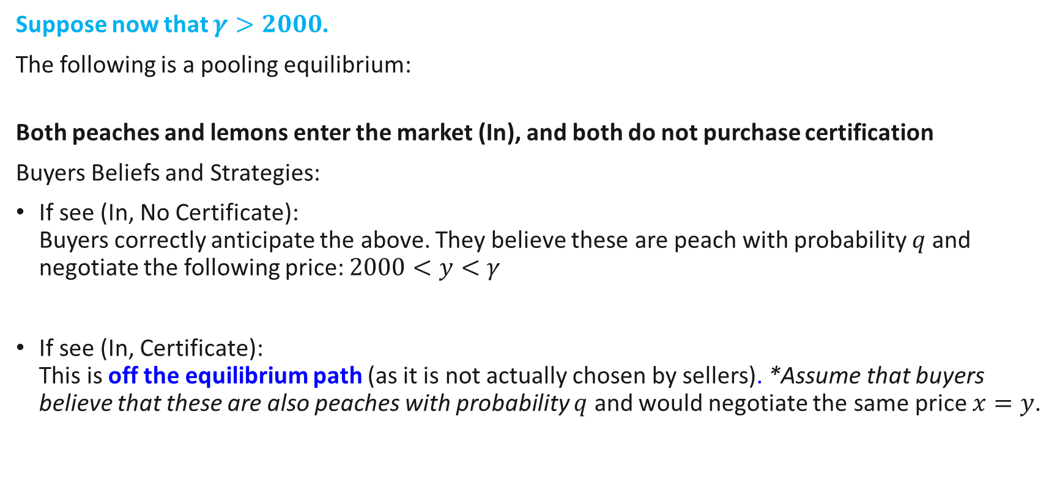
Pooling Equilibrium 1 (with signalling)
Suppose now that $γ>2000$.
The following is a pooling equilibrium:
Both peaches and lemons enter the market (In), and both do not purchase certification
Buyers Beliefs and Strategies:
If see (In, No Certificate): Buyers correctly anticipate the above. They believe these are peach with probability $q$and negotiate the following price: $2000<y<γ$
If see (In, Certificate): This is off the equilibrium path (as it is not actually chosen by sellers). *Assume that buyers believe that these are also peaches with probability $q$ and would negotiate the same price $x=y$.

Slide 34
Pooling Equilibrium 1 (with signalling)
These are all best responses!
Both sellers will not want to leave the market because they are earning more than their own valuation.
Both sellers will not want to certify because this does not give them any benefits (given the equilibrium beliefs and negotiated prices of buyers)
Here, the equilibrium is the same as before (Slide 10)!
But is it the only possible pooling equilibrium?

Slide 35
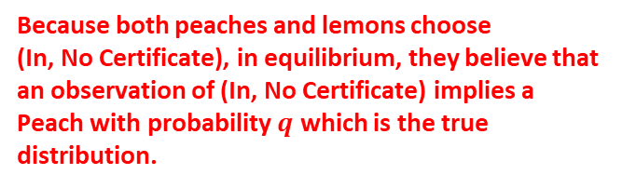
Beliefs on/off the equilibrium path.
Recall that buyers only observe 1) sellers who enter, 2) whether they have a certificate.
They form beliefs about sellers depending on these observations which influences their expected value. Two potential observations: (In, Certificate) & (In, No Certificate)
How do we determine their beliefs? We assume that in equilibrium, they anticipate seller’s strategies correctly!
Pooling Equilibrium 1
Peaches & Lemons:
(In, No Certificate)
(In, Certificate)
Strategy
Belief
Belief???
Because both peaches and lemons choose (In, No Certificate), in equilibrium, they believe that an observation of (In, No Certificate) implies a Peach with probability $q$ which is the true distribution.
What should they think about a strategy that is not chosen in equilibrium?
No correct belief, so we assume that they can believe anything!*

Slide 36
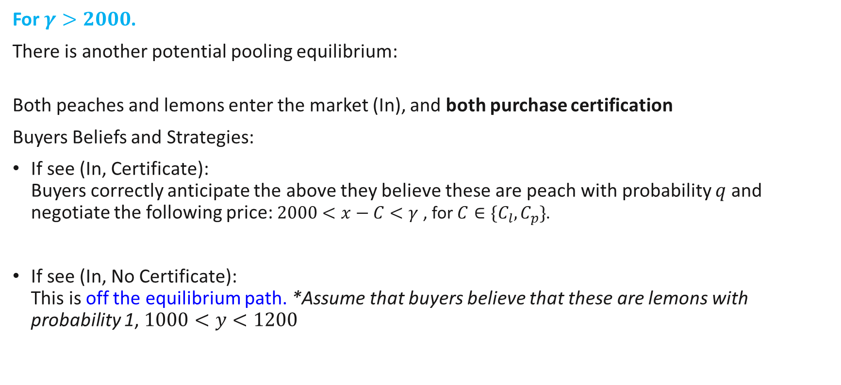
Pooling Equilibrium 2 (with signalling)
For $γ>2000$.
There is another potential pooling equilibrium:
Both peaches and lemons enter the market (In), and both purchase certification
Buyers Beliefs and Strategies:
If see (In, Certificate): Buyers correctly anticipate the above they believe these are peach with probability $q$and negotiate the following price: $2000<x−C<γ$ , for $C∈\{C_{l},C_{p}\}$.
If see (In, No Certificate): This is off the equilibrium path. *Assume that buyers believe that these are lemons with probability 1, $1000<y<1200$

Slide 37
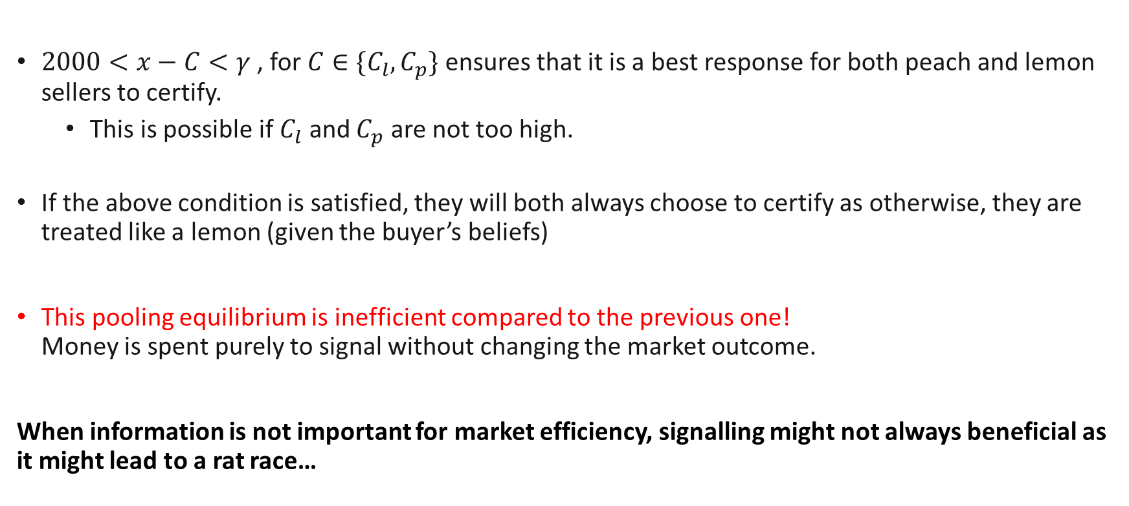
Pooling Equilibrium 2 (with signalling)
$2000<x−C<γ$ , for $C∈\{C_{l},C_{p}\}$ ensures that it is a best response for both peach and lemon sellers to certify.
This is possible if $C_{l}$ and $C_{p}$ are not too high.
If the above condition is satisfied, they will both always choose to certify as otherwise, they are treated like a lemon (given the buyer’s beliefs)
This pooling equilibrium is inefficient compared to the previous one! Money is spent purely to signal without changing the market outcome.
When information is not important for market efficiency, signalling might not always beneficial as it might lead to a rat race…

Slide 38

General steps for Signalling Equilibria
Suppose there are two types of first movers: $i$ and $j$
In a scenario where second mover has incomplete information about the first mover and we are checking whether there is an equilibrium where first movers do $X_{i},X_{j}$
Consider the strategies $X_{i},X_{j}$.
Assume that the second mover has correct beliefs about what each type will do.
If there is no “correct belief”, any belief can be specified.
Get the second mover’s best responses.
Given the second mover’s best response, check whether $X_{i}$ and $X_{j}$ are best responses for the first mover types.

Slide 39
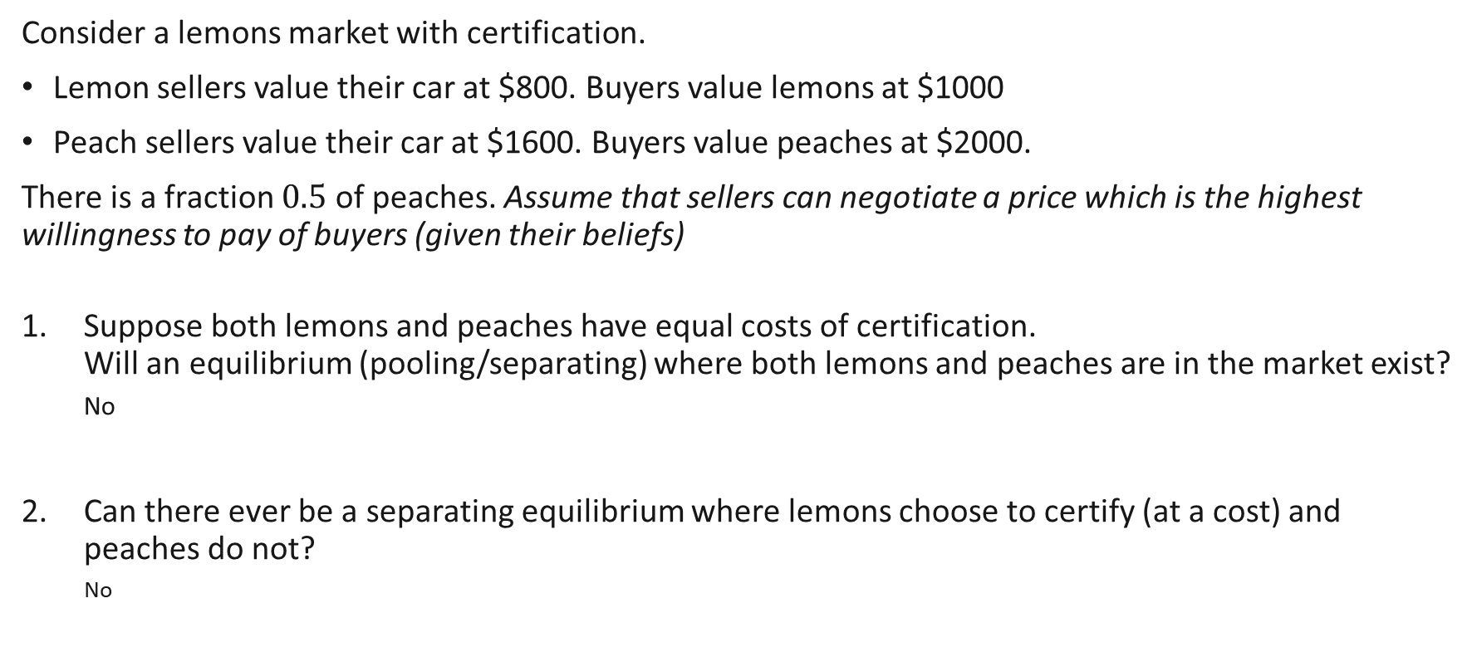
Review Questions 3
Consider a lemons market with certification.
Lemon sellers value their car at $800. Buyers value lemons at $1000
Peach sellers value their car at $1600. Buyers value peaches at $2000.
There is a fraction $0.5$ of peaches. Assume that sellers can negotiate a price which is the highest willingness to pay of buyers (given their beliefs)
Suppose both lemons and peaches have equal costs of certification. Will an equilibrium (pooling/separating) where both lemons and peaches are in the market exist?
No
Can there ever be a separating equilibrium where lemons choose to certify (at a cost) and peaches do not?
No

Slide 40
Key Learning Outcomes
When and how does adverse selection lead to inefficiency in markets?
Solving for pooling/separating/partial pooling equilibria with incomplete information about different types in the market.
Beliefs (on/off equilibrium path), Best responses.
How does allowing for signalling influence efficiency?
Solving for similar equilibria, allowing for (costly) signals.

Slide 41
Readings
Varian, Chapter 38
For your interest:
Pooling Equilibria for Amazon Products?
Signalling for foreign policy

Slide 42
Additional Example: Labour Market Signalling

Slide 43
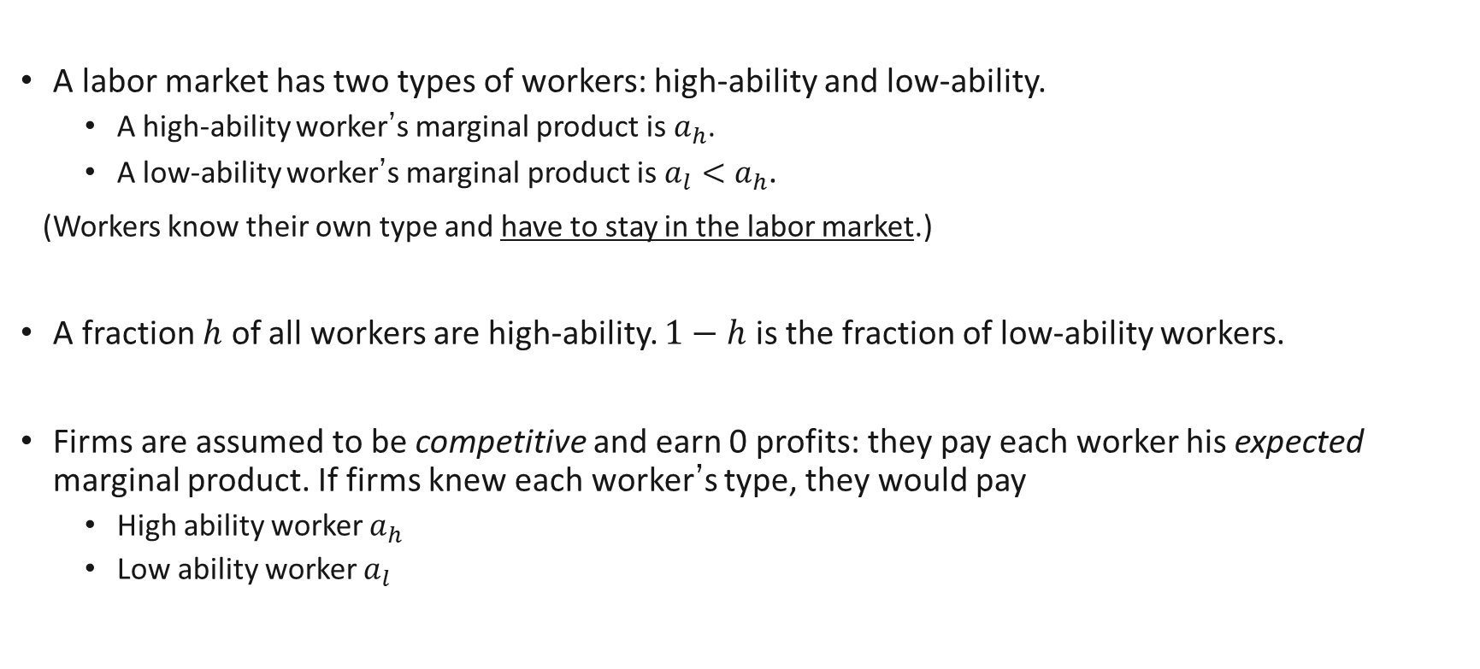
Labor Market Signalling
A labor market has two types of workers: high-ability and low-ability.
A high-ability worker’s marginal product is $a_{h}$.
A low-ability worker’s marginal product is $a_{l}<a_{h}$.
(Workers know their own type and have to stay in the labor market.)
A fraction $h$ of all workers are high-ability. $1−h$ is the fraction of low-ability workers.
Firms are assumed to be competitive and earn 0 profits: they pay each worker his expected marginal product. If firms knew each worker’s type, they would pay
High ability worker $a_{h}$
Low ability worker $a_{l}$

Slide 44
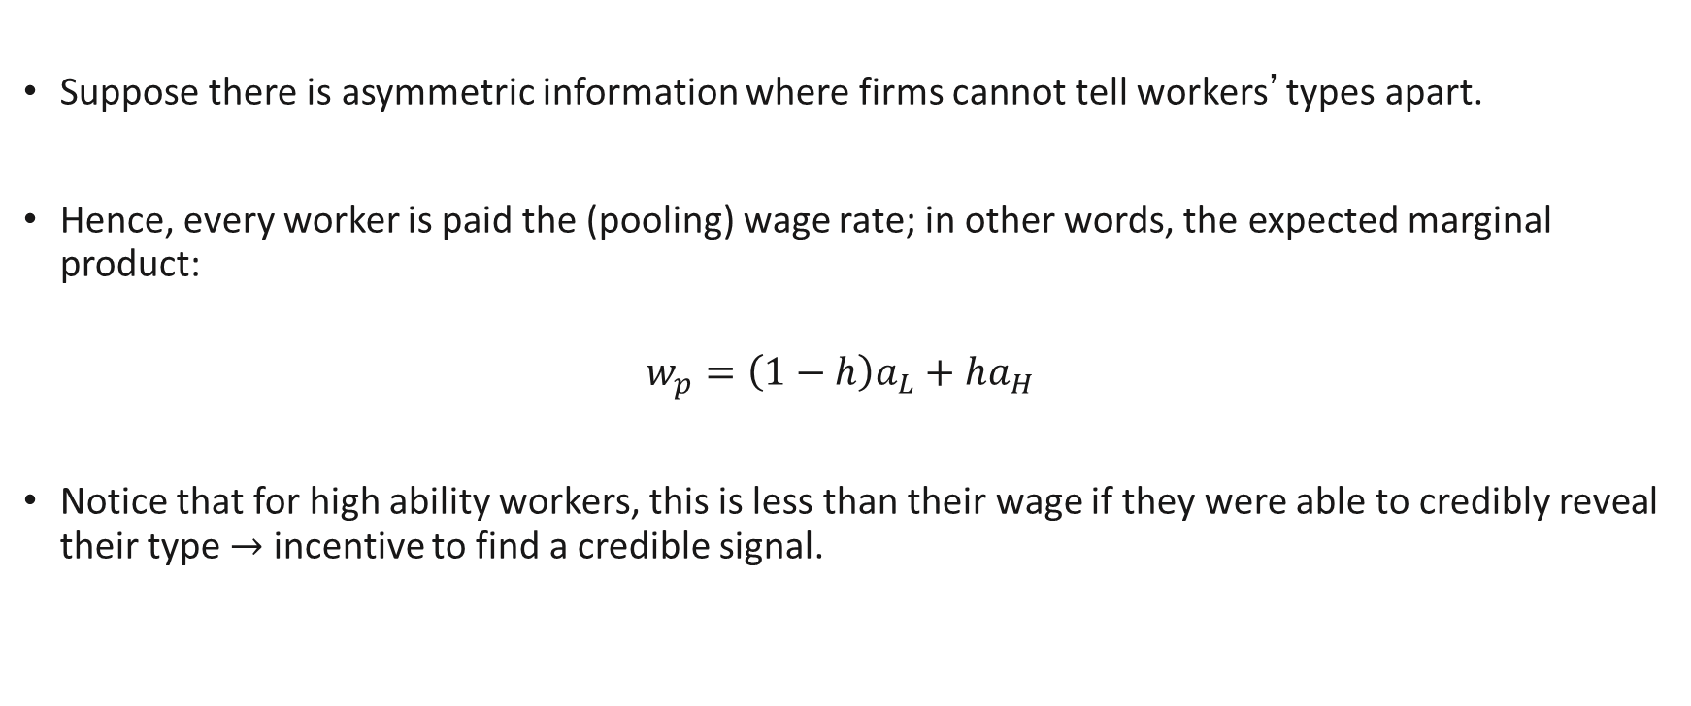
Labor Market Signalling
Suppose there is asymmetric information where firms cannot tell workers’ types apart.
Hence, every worker is paid the (pooling) wage rate; in other words, the expected marginal product:
$$w_{p}=\left(1−h\right)a_{L}+ha_{H}$$
Notice that for high ability workers, this is less than their wage if they were able to credibly reveal their type $→$ incentive to find a credible signal.

Slide 45
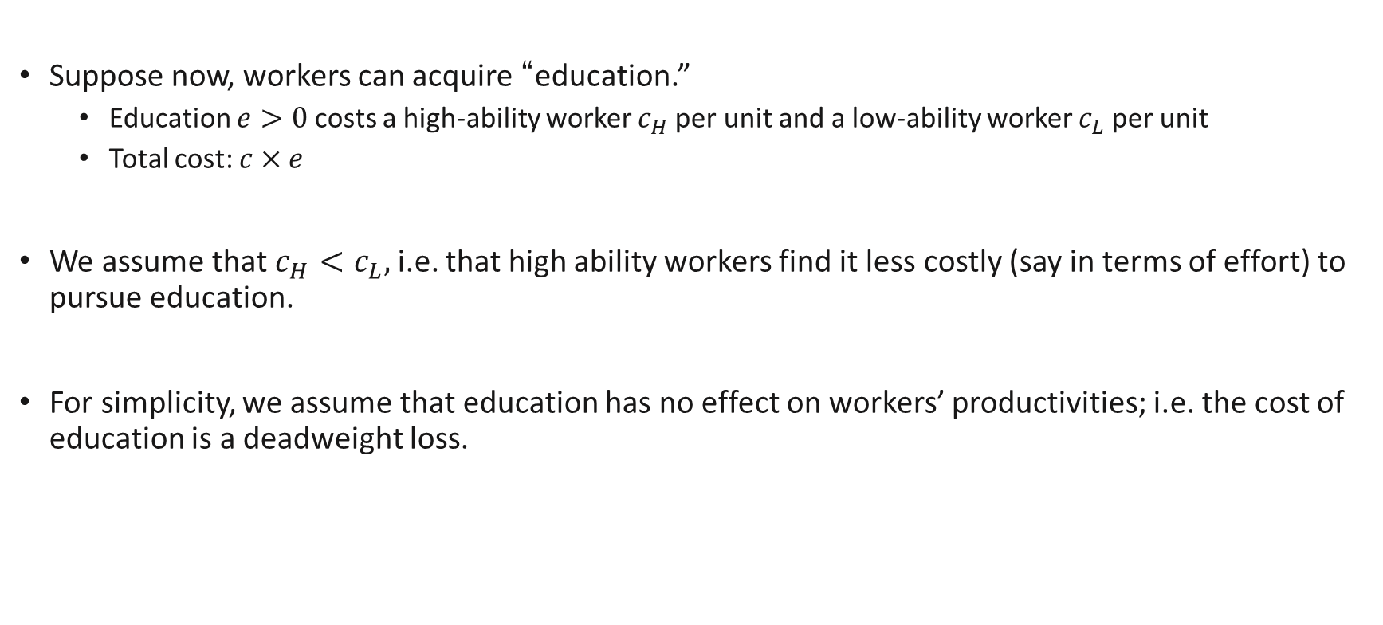
Labor Market Signalling
Suppose now, workers can acquire “education.”
Education $e>0$ costs a high-ability worker $c_{H}$per unit and a low-ability worker $c_{L}$ per unit
Total cost: $c×e$
We assume that $c_{H}<c_{L},$ i.e. that high ability workers find it less costly (say in terms of effort) to pursue education.
For simplicity, we assume that education has no effect on workers’ productivities; i.e. the cost of education is a deadweight loss.

Slide 46
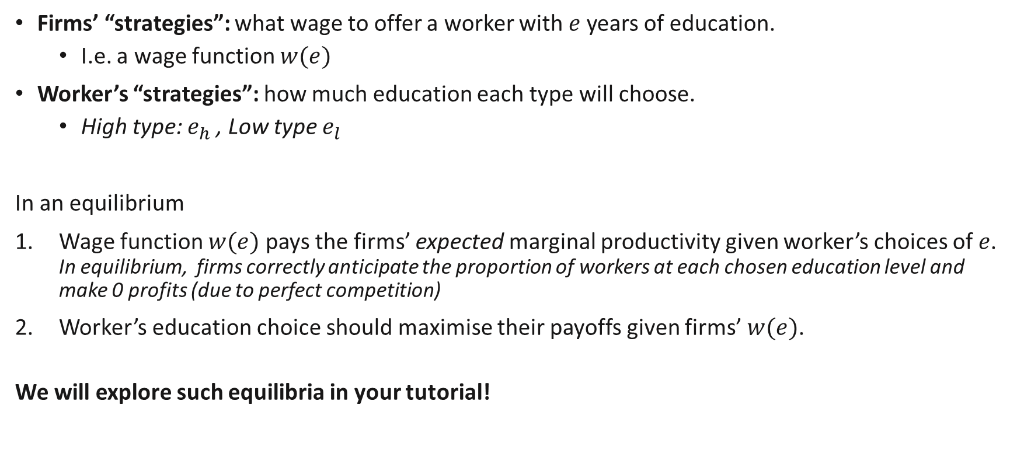
Labor Market Signalling Equilibria
Firms’ “strategies”: what wage to offer a worker with $e$years of education.
I.e. a wage function $w(e)$
Worker’s “strategies”: how much education each type will choose.
High type: $e_{h}$, Low type $e_{l}$
In an equilibrium
Wage function $w(e)$ pays the firms’ expected marginal productivity given worker’s choices of $e$. In equilibrium, firms correctly anticipate the proportion of workers at each chosen education level and make 0 profits (due to perfect competition)
Worker’s education choice should maximise their payoffs given firms’ $w(e)$.
We will explore such equilibria in your tutorial!

